Slide 1

BOSTON CRIME
Carter Bentinganan, Christopher Lue, Duygu Simsek, and Kimberly Smith

Slide 2
BACKGROUND AND PURPOSE
BACKGROUND
Crime is one of the complex social problems that has grown over time with the increase in population and has significant impacts directly on victims and indirectly on the community.
Boston is the capital and most populous city of the Commonwealth of Massachusetts in the United States and the 24th-most populous city in the country.
Boston has one of the highest crimes in the United States.
It has been recorded 4,378 violent crimes in 2020 in Boston, giving it a violent crime rate of 6.48 per 1,000 people. There were 58 murders, 193 rapes, 923 robberies, and 3,204 sex assaults.
PURPOSE
The purpose of this analysis is to provide proper police staffing by determining the frequencies, times, and locations crimes are committed.

Slide 3
ANALYSIS
EXTRACT
Our date was extracted from https://data.boston.gov/dataset/crime-incident-reports-august-2015-to-date-source-new-system/resource/f4495ee9-c42c-4019-82c1-d067f07e45d2
We downloaded the CSV file containing the crime data from 2021
We uploaded the CSV file into python to begin or analysis.
TRANSFORM
We cleaned up the data by deleting irrelevant columns and created data frames for relevant columbs.
LOAD
The data was loaded and stored in SQL.

Slide 4

MACHINE LEARNING

Slide 5

MACHINE LEARNING
For this analysis, we will utilize an unsupervised machine learning model (clustering) in order to determine Boston’s crime rate and areas on the given day and time.
The dataset will be divided into two parts training and testing using clustering and K-Means algorithm.
Visualizing the results by graphs and charts will help understand better the dataset, crime hotspot areas, crime types, and crime patterns.

Slide 6
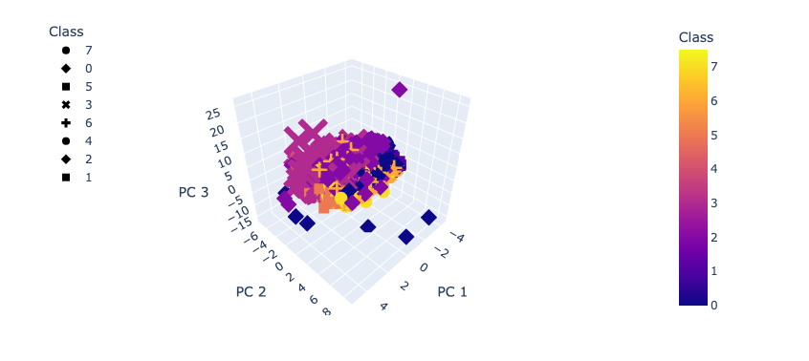
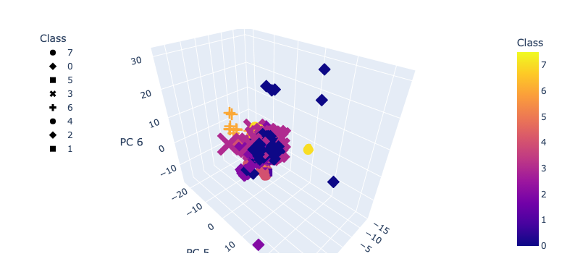
MACHINE LEARNING
CLUSTERING

Slide 7

DASHBOARD

Slide 8
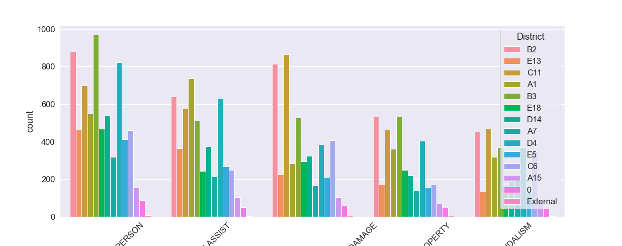
CRIMES PER DISTRICT

Slide 9
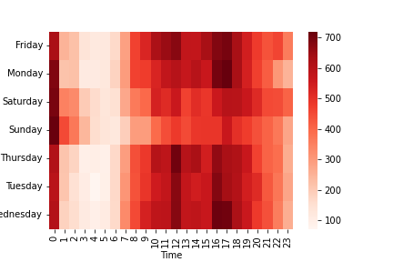
CRIMES BY DAY AND TIME

Slide 10
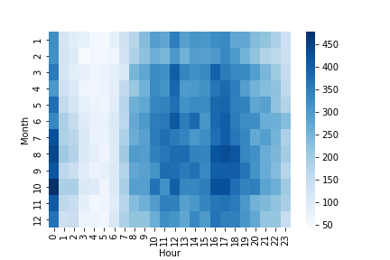
CRIMES BY MONTH AND HOUR

Slide 11
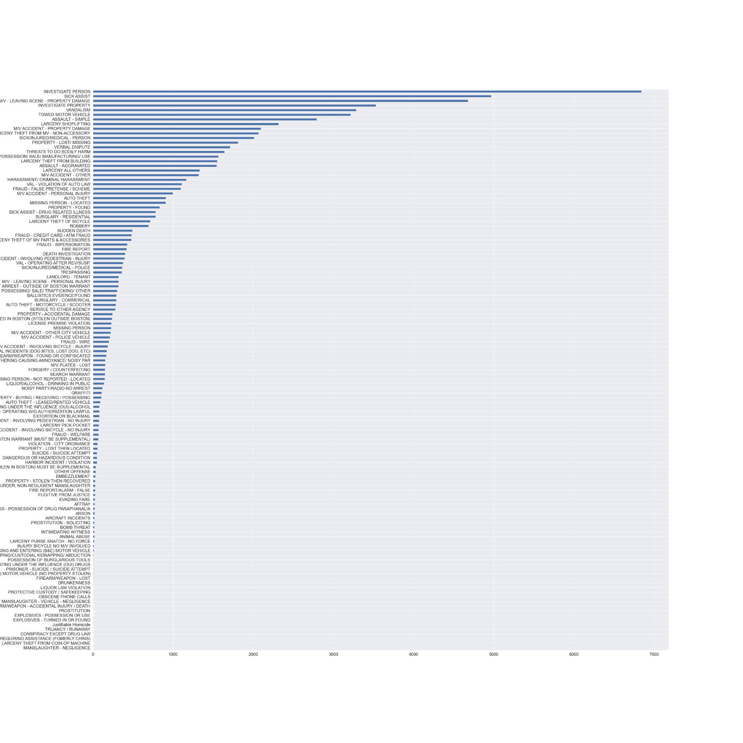
COUNT OF CRIMES

